Slide 1
Fall 2020
DATS 501 Fundamentals of Data Science
Hasan Demirtaş
hdemirtas.academic@gmail.com

Slide 2
Unsupervised Learning

Slide 3
Unsupervised vs Supervised

Slide 4
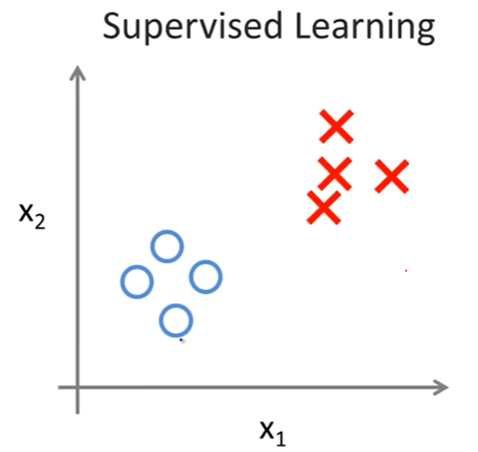
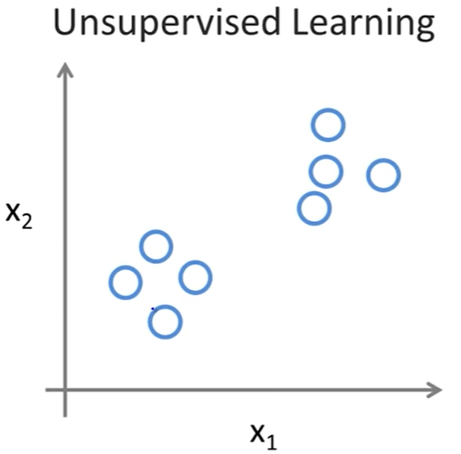
Supervised vs Unsupervised
Labeled data
There is no label
What to do when there is no labels?

Slide 5
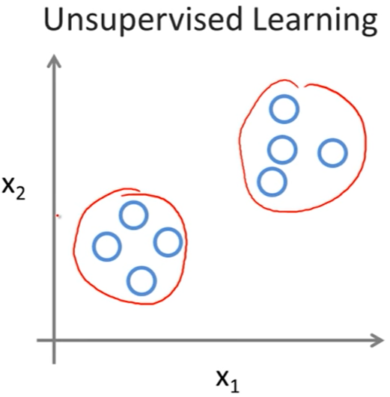
Unsupervised Learning
Answer: Grouping
Notes:
The data is taken from a sample of 50 soft drink purchases.
Each purchase is for one of five popular soft drinks, which define the five bins: Coca-Cola, Diet Coke, Dr. Pepper, Pepsi, and Sprite.

Slide 6
Unsupervised Learning – Clustering Concept
Clustering:
Groups data regarding similarity / dissimilarity
Flat clustering and hierachical clustering are two major types
Distance based versions are popular and k-means is the most popular one among clustering algorithms
Notes:
The data is taken from a sample of 50 soft drink purchases.
Each purchase is for one of five popular soft drinks, which define the five bins: Coca-Cola, Diet Coke, Dr. Pepper, Pepsi, and Sprite.

Slide 7
Unsupervised Learning – Major Types
Partitional (Flat) algorithms
Usually start with a random (partial) partitioning
Refine it iteratively
K means clustering
(Model based clustering)
Hierarchical algorithms
Bottom-up, agglomerative
(Top-down, divisive)
Notes:
The data is taken from a sample of 50 soft drink purchases.
Each purchase is for one of five popular soft drinks, which define the five bins: Coca-Cola, Diet Coke, Dr. Pepper, Pepsi, and Sprite.

Slide 8
Unsupervised Learning – Clustering Concept
Hard clustering
Each document belongs to exactly one cluster
More common and easier to do
Soft clustering
Makes more sense for applications like creating browsable hierarchies
You may want to put a pair of sneakers in two clusters: (i) sports apparel and (ii) shoes
We will cover hard clustering
Notes:
The data is taken from a sample of 50 soft drink purchases.
Each purchase is for one of five popular soft drinks, which define the five bins: Coca-Cola, Diet Coke, Dr. Pepper, Pepsi, and Sprite.

Slide 9
Unsupervised Learning – Clustering Methods

Slide 10
Partitional Algorithms
K-means working method
K number is given by human to tell the algorithm how many clusters will be created
K can be found by trying different K values and getting best performing K according to
The Elbow Method: Total distance of data points to cluster center
The Silhouette Method: Belonging rating of data points between -1 and 1 to a cluster compared to other clusters
An initial p1 is placed in the space
Another p2 point is placed a far opposite place compared to p2. Then p3 point is placed far away from p1 and p2
Points p4 .... pK are placed in the space in this manner
Notes:
The data is taken from a sample of 50 soft drink purchases.
Each purchase is for one of five popular soft drinks, which define the five bins: Coca-Cola, Diet Coke, Dr. Pepper, Pepsi, and Sprite.

Slide 11
Partitional Algorithms
K-means working method cont.
K number is given by human to tell the algorithm how many clusters will be created
K can be found by trying different K values and getting best performing K according to
The Elbow Method: Total distance of data points to cluster center
The Silhouette Method: Belonging rating of data points between -1 and 1 to a cluster compared to other clusters
An initial p1 is placed in the space
Another p2 point is placed a far opposite place compared to p2. Then p3 point is placed far away from p1 and p2
Points p4 .... pK are placed in the space in this manner
Notes:
The data is taken from a sample of 50 soft drink purchases.
Each purchase is for one of five popular soft drinks, which define the five bins: Coca-Cola, Diet Coke, Dr. Pepper, Pepsi, and Sprite.

Slide 12
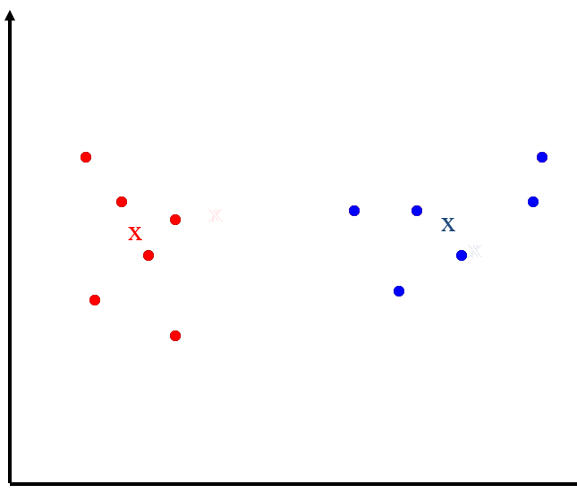
Partitional Algorithms
K-means working method cont. – 2 clusters example
Pick cluster centers
Assign data points to centers
Compute the new centers
Assing data points to new centers
Converged ☺
Notes:
The data is taken from a sample of 50 soft drink purchases.
Each purchase is for one of five popular soft drinks, which define the five bins: Coca-Cola, Diet Coke, Dr. Pepper, Pepsi, and Sprite.

Slide 13
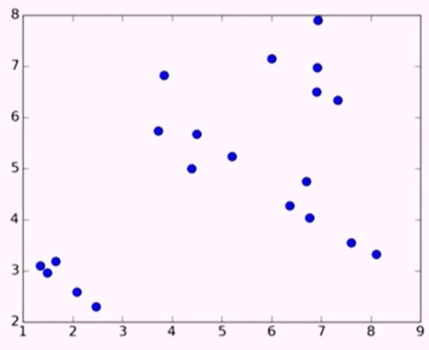
Partitional Algorithms
K-means working method cont. – 4 clusters example
Generated data
Notes:
The data is taken from a sample of 50 soft drink purchases.
Each purchase is for one of five popular soft drinks, which define the five bins: Coca-Cola, Diet Coke, Dr. Pepper, Pepsi, and Sprite.

Slide 14
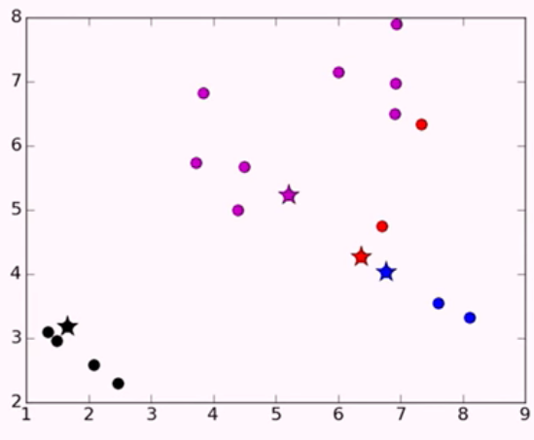
Partitional Algorithms
K-means working method cont. – 4 clusters example
Randomly chosen initial points are added
Classes are assigned to them
Notes:
The data is taken from a sample of 50 soft drink purchases.
Each purchase is for one of five popular soft drinks, which define the five bins: Coca-Cola, Diet Coke, Dr. Pepper, Pepsi, and Sprite.

Slide 15
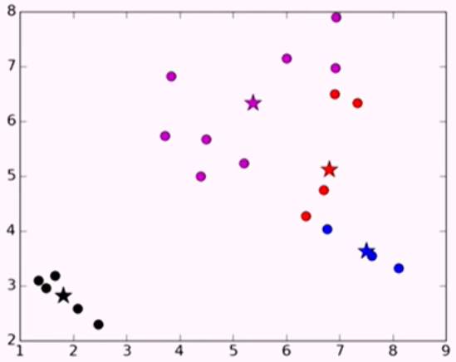
Partitional Algorithms
K-means working method cont. – 4 clusters example
Notes:
The data is taken from a sample of 50 soft drink purchases.
Each purchase is for one of five popular soft drinks, which define the five bins: Coca-Cola, Diet Coke, Dr. Pepper, Pepsi, and Sprite.

Slide 16
Partitional Algorithms
K-means working method cont. – 4 clusters example
Iteration 1
Notes:
The data is taken from a sample of 50 soft drink purchases.
Each purchase is for one of five popular soft drinks, which define the five bins: Coca-Cola, Diet Coke, Dr. Pepper, Pepsi, and Sprite.

Slide 17
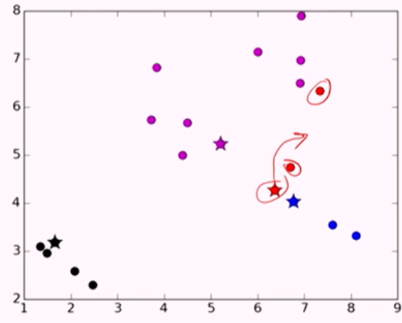
Partitional Algorithms
K-means working method cont. – 4 clusters example
Iteration 1 : centroid move
Notes:
The data is taken from a sample of 50 soft drink purchases.
Each purchase is for one of five popular soft drinks, which define the five bins: Coca-Cola, Diet Coke, Dr. Pepper, Pepsi, and Sprite.

Slide 18
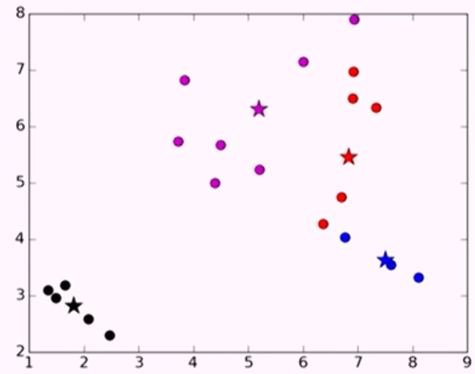
Partitional Algorithms
K-means working method cont. – 4 clusters example
Iteration 2 :
Notes:
The data is taken from a sample of 50 soft drink purchases.
Each purchase is for one of five popular soft drinks, which define the five bins: Coca-Cola, Diet Coke, Dr. Pepper, Pepsi, and Sprite.

Slide 19
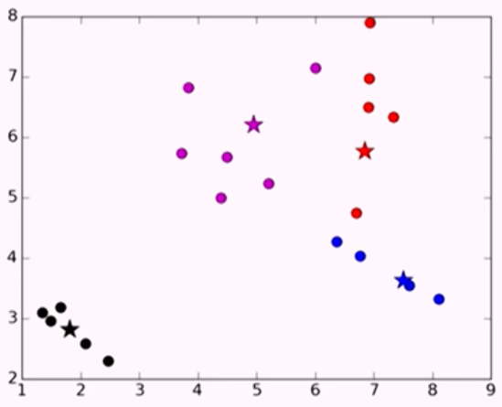
Partitional Algorithms
K-means working method cont. – 4 clusters example
Iteration 3 :
Notes:
The data is taken from a sample of 50 soft drink purchases.
Each purchase is for one of five popular soft drinks, which define the five bins: Coca-Cola, Diet Coke, Dr. Pepper, Pepsi, and Sprite.

Slide 20
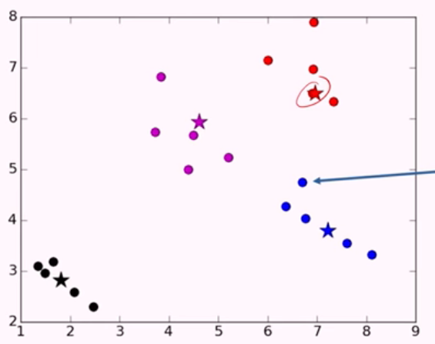
Partitional Algorithms
K-means working method cont. – 4 clusters example
Iteration 4 :
Notes:
The data is taken from a sample of 50 soft drink purchases.
Each purchase is for one of five popular soft drinks, which define the five bins: Coca-Cola, Diet Coke, Dr. Pepper, Pepsi, and Sprite.

Slide 21
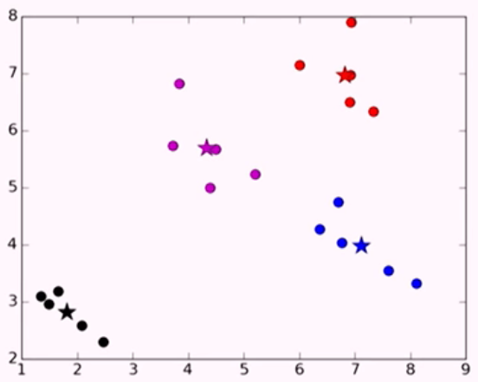
Partitional Algorithms
K-means working method cont. – 4 clusters example
Iteration 5 :
Notes:
The data is taken from a sample of 50 soft drink purchases.
Each purchase is for one of five popular soft drinks, which define the five bins: Coca-Cola, Diet Coke, Dr. Pepper, Pepsi, and Sprite.

Slide 22
Partitional Algorithms
K-means iterations and convergence
Number of iterations may seem as a problem
K-means is a special case of a general procedure known as the Expectation Maximization (EM) algorithm. EM is claimed to be known as an algorithm that converge
The error is monotonically decreasing
Practically it converges fast
Notes:
The data is taken from a sample of 50 soft drink purchases.
Each purchase is for one of five popular soft drinks, which define the five bins: Coca-Cola, Diet Coke, Dr. Pepper, Pepsi, and Sprite.

Slide 23
Partitional Algorithms
K-means outlier
It does not have any features to handle outliers
K-means utilizes features numerically
Features are used as numeric meaning they needed to be scaled regarding their importance before usage
Notes:
The data is taken from a sample of 50 soft drink purchases.
Each purchase is for one of five popular soft drinks, which define the five bins: Coca-Cola, Diet Coke, Dr. Pepper, Pepsi, and Sprite.

Slide 24
Partitional Algorithms
K-means outlier solution?
K-medoids
Uses medoids ( a real data point instead of centroid ) for cluster centers.
When an outlier tries to deviate clusters from grouped data and there is no data close to that center, the data center is chosen from closest actual data point
Notes:
The data is taken from a sample of 50 soft drink purchases.
Each purchase is for one of five popular soft drinks, which define the five bins: Coca-Cola, Diet Coke, Dr. Pepper, Pepsi, and Sprite.

